Slide 1
DocuShare® Go Content Management Platform Data and documents that organize themselves.
Notes:
Welcome and thank you for your time and allowing me to present our new Content Management platform, DocuShare Go.
Over the next 20 minutes or so, I’ll cover what this means for your business, employees and your customers, as well as key strengths of this new platform.

Slide 2
Planning for the Future Now
Businesses say they plan to return most employees to the office eventually while expanding remote working policies.
TOP 3 PRIORITIES:
Cloud-based software
Remote IT support
Collaboration software
Source: The Xerox 2020 Future of Work Survey conducted by Vanson Bourne
Notes:
No surprise, the COVID-19 pandemic has upended work as we know it. The return to the workplace will happen / is happening, but there are still questions about how it will look and what organizations need to prepare for as they adjust to a period where we manage a distributed workforce. ​
​At the back-end of 2020 Xerox conducted a global survey of IT decision makers and senior C-level professionals to learn what returning to the workplace will look like specifically for their organizations. We looked at a how a hybrid model of in-office and working from home will affect buying decisions over the next 18-24 months. ​
​What we learned is that many businesses are using this time now to make lasting changes to safeguard their business for the long haul. ​
Here are some additional insights:​
82% of businesses plan to return most employees to the office in 12-18 months’ time
58% of businesses intend to change their work from home policy within the next year, allowing those who can do so to work remote indefinitely. This means businesses plan to return most employees to the office but expanded remote work policies are here to stay.
34% are planning to speed their digital transformation.
Also, companies are now placing a renewed focus on meeting employees’ needs with both hardware and software and are focused on these three areas:
Cloud-based software​
Remote IT support​
Collaboration software​
[Ask your client if they can relate to any of these stats and ask them to discuss their plans]
[If questioned on survey scope]
Scope : Private / Public Sector​
Org size: 500+ employees​
Countries : US/Canada/UK/France/Germany​

Slide 3
DocuShare Go Laying the foundation for future business growth.
WHAT IT IS:
DocuShare Go is a cloud-hosted (SaaS) collaborative Content Services Platform for business-centric processes that uses the latest artificial intelligence (AI) / machine learning (ML) technology.
WHAT IT DOES:
Simplifies conversion of paper content, secure storage and retrieval of digital files. Drives productivity with workflow automation and team sharing that includes real-time document collaboration.
HOW IT HELPS:
Saves time and money. Fast tracks digital transformation with future-ready capabilities while protecting data and making it easier to stay in compliance.
Notes:
The previous slide shows retrospective actions; however, they do highlight the realization of having a more flexible approach to how business needs to run.
At the heart of any business is a process, in most cases, several, along with the systems needed to make them flow.
Whether these are paper based, fully digital or a mix of both, not having access to the systems you need, businesses simply stall and why Covid had such an impact for many that weren’t prepared to be able to work remotely from the office.
Yes, throughout the pandemic, many found workarounds and learnt new ways to work, but these often less secure and most definitely, less productivity than doing it in the office.
Depending on where you are with your digital transformation initiatives or how you adapted to the challenges faced, we believe DocuShare Go can support your business whether you return fully to the office, or you adopt a more hybrid environment for your employees, DocuShare Go can help lay the foundation of future growth and be the heart of your content management and process automation requirements.
Data and documents should support business growth, not get in the way of it.
DocuShare Go makes it possible to spend less time managing documents, and more time running your business.
Here are a few key highlights:
Advanced AI technology recognizes captured content, tags it and stories it without human intervention
Seamless, secure collaboration, so you can stay connected with confidence
Intuitive usage dashboard and auditing capabilities provide complete visibility
A platform that’s as flexible as your content — store and manage everything from written notes, to videos, forms and more
Let’s talk about how DocuShare Go balances world-class security with frictionless accessibility.

Slide 4
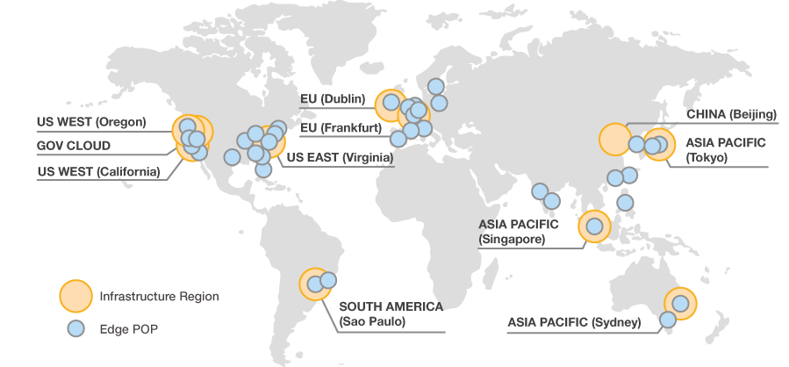
Cloud Hosted Secure and accessible anywhere, anytime.
THE HIGHEST STANDARDS FOR PRIVACY AND DATA SECURITY
Using the Amazon Web Services (AWS) platform, DocuShare Go is hosted on the most secure global infrastructure.*
THE MOST COMPREHENSIVE SECURITY AND COMPLIANCE CONTROLS
AWS regularly achieves third-party validation for thousands of global compliance requirements that is continually monitored to help meet security and compliance standards for finance, retail, healthcare, government and beyond.
Encrypting data at rest and in motion
Encryption at rest using AES-256
Encrypting data in motion using Transport Layer Security (TLS) protocol
DocuShare Go also includes
Multi-Factor Authentication (MFA), admin selectable
User selectable SMS or Authentication App for MFA requests
Global Infrastructure
Source: https://aws.amazon.com/about-aws/global-infrastructure/
*DocuShare Go will be hosted in the US (East) and EU (German) data centres only.
Notes:
Xerox treats data security as a number one priority, as such, we go to great lengths to ensure all our software solutions offer the most stringent security protocols available. We also partner with industry recognized leaders, like Amazon, to maximize global reach while not compromising on the security standards we set.
DocuShare Go utilizes the AWS hosting platform for the following reasons;
It offers the highest standards for privacy and data security:
All data flowing across the AWS global network that interconnects data centers and regions is automatically encrypted at the physical layer before it leaves AWS secured facilities.
Compliments with the most comprehensive security and compliance controls:
AWS regularly achieves third-party validation for thousands of global compliance requirements that are continually monitored to meet security and compliance standards for finance, retail, healthcare, government, and beyond.
Learn more at : https://aws.amazing.com/security
Secures data channels with encryption at rest and in motion
Encryption at rest using AES-256
Encrypting data in motion using Transport Layer Security (TLS) protocol
DocuShare Go also adds additional layers of security features such as;
Multi-Factor Authentication (MFA)

Slide 5
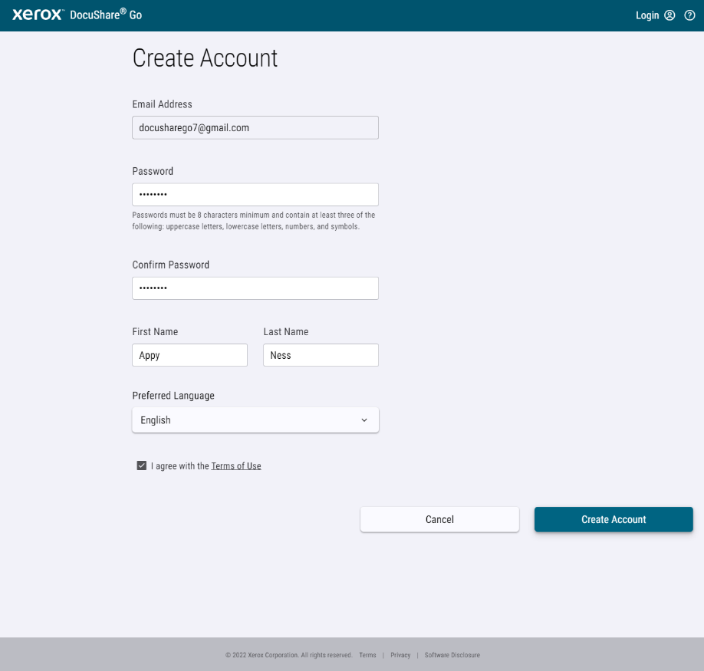
Account Creation Simple, quick and no need for IT assistance.
Progressive Web App Browser Support
Chrome, Edge, Safari
Account Sign-Up Page
No billing details for free trial
Enable Enhanced Security
Multi-Factor Authentication
Notes:
DocuShare Go has been built from the ground up to be simple to set up and use without compromising capabilities.
Being cloud hosted (SaaS) account creation is fast and 1-2-3 easy meaning you get up and running in a matter of minutes, not days.
There’s no need to download software or maintain any hardware, cloud hosting means everything is updated and maintained in the background allowing for you to gain 24/7 uptime without the worry.
Even for those non-IT users, powerful security features, like multi-factor authentication, can be enabled at a click of a button.
The licensing subscription model allows for you to purchase what you need, when you need it, so no more paying for what you don’t use.
A free 30-day trial is available so you can try before you buy, you don’t need to enter any purchase information until you are ready to subscribe.

Slide 6
Account Creation Purchase what you need, when you need it.
SUBSCRIPTION OPTIONS:
Free Trial
30 day (5 users max, 3Gb data per invited user)
No payment details needed
Named User Plan*
Includes 500Gb data storage
Concurrent User (5 user packs)*
Includes 5Tb pooled data storage
*only available through Xerox Direct Sales or Xerox Channel Partners
*Subject to change
Notes:
Subscription purchases are limited to named user plans and concurrent user plans (in packs of 5 users), both options can be purchased from your DocuShare sales representative or preferred Xerox channel partner.
The 30 day free trial is available for anyone, just sign up for an account, invite additional users (up to 4), and get going.
The free trial does not need any purchasing information to be shared.

Slide 7
Access Control Easy to invite team members and assign roles.
MAIN ACCOUNT MEMBERS
Subscription owners and administrators invite users to the account.
Subscription Owner
Full write permissions and no management restrictions.
Administrator
Full write permissions and no management restrictions.
User
Collection level write permissions and no management restrictions.
Guest
File or Folder level access only, can be an editor or view only.
Notes:
Access control is fundamental for security and compliance, ensuring only those with permission to access files of folders is achieved by simple profiling of each invited user.
Once your main account is set up, it’s easy to invite team members via their email address, assigning admin or user roles at point of invite, this can be changed later if needed.
A list of profiles and permissions as follows:
Subscription owner
The owner role has full ‘write’ permissions to all collection policies and content files and folders.
Users associated with the owner role have no management restrictions.
Administrator
The administrator role has ‘write’ permissions for targeted collection policies and content files and folders.
Administrators can invite users to the main account.
User
Have their own dashboard, where they can create collections and invite members to those collections.
Have read/write permissions to any collection, folder or file they have been invited to.
Cannot view collections, folders or files they have not been invited to.
Guest
Access can be granted to individuals that do not belong to the main account, these can be internal colleagues or external customers.
They can be granted editor or view only permissions.
They do not see any account information beyond the individual folder or file they have been invited to.

Slide 8
Access Control Team collaboration through collections.
COLLECTION OWNERS AND MEMBERS
Collection owners invite and set access level for each member.
Owner
Full write permissions and no management restrictions.
Manager
Limited write permissions – enough to manage day-to-day tasks.
Editor
Write permissions only for content creation and management.
Contributor
Viewer permissions with the ability to upload files.
Viewer
Standard read-only role with no editing capabilities.
Notes:
Collections are created and owned by the subscription owner (at account level) or account members, at the user level.
Once a collection is set up, only invited members will see and have access to it, there is no limit to the amount of collections you own or belong to.
Collection Owner
The owner role has full ‘write’ permissions to all collection policies and content files and folders.
Users associated with the owner role have no management restrictions within their own account.
Manager
The manager role has ‘write’ permissions for targeted collection policies and content files and folders.
Users associated with the manager have enough permissions to manage the day-to-day logistics of a collection.
Editor
The editor has ‘write’ permissions for only content files and folders.
Users in this role are primarily content creators and managers.
Contributor
The contributor role is like a ‘read-only’ role with the exception that upload file management action is allowed.
No other file and folder editing options are allowed including inline editing.
The ability to preview and download files is still supported with this level of permissions.
Users associated with updater role cannot participate in live collaboration (write permission required).
Viewer
The viewer role is a standard ‘read-only’ role with no editing options.
The ability to preview and download files is still supported with this level of permissions.
Users associated with the viewer role cannot participate in live collaboration (‘write’ permission required).

Slide 9
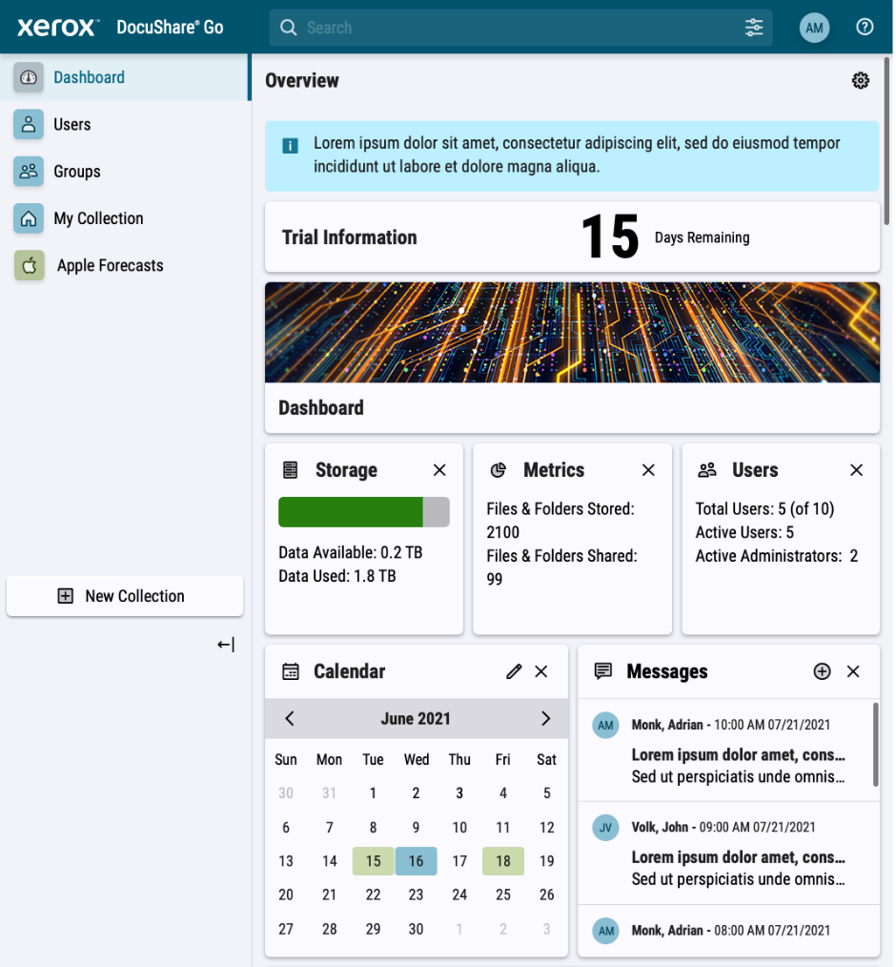
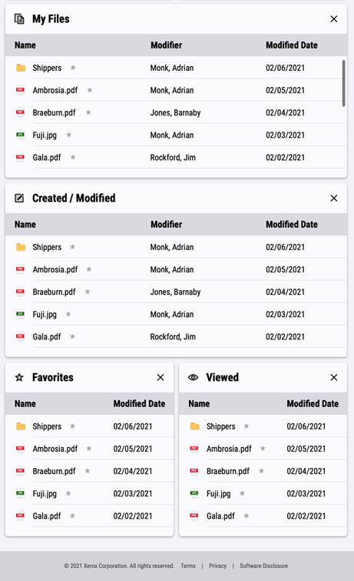
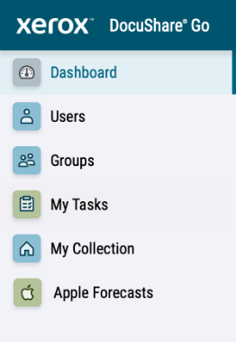
Home Page/Dashboard Offers complete visibility over account activities.
HOME PAGE / DASHBOARD
Clean and fresh design provides visibility over key account status and activities. Widget driven to allow for user customization.
1. Menu navigation
Management (admin only), Tasks, Groups & Collections
Account members have their own personal collection dashboard
Collections can be created by all users but only visible by those invited to them
2. System Notification bar
Dynamically appears when notifications are triggered
3. Image Widget
Vanity image to help account identification
4. Analytic Widget
Account information (only available to account owners/admins)
5. Communication Widget
Displays an editable calendar and user posted messages
6. File Access / Management Widget
Overview of recent file activity and quick access to commonly used files
Lists all current workflow tasks
2
3
1
6
4
5
See how widgets work here
Notes:
DocuShare Go was designed with the individual user in-mind, its intuitive, single-view and customizable dashboard, gives complete visibility over recent activities and required actions.
Each widget can be dragged to a different location, resized or removed, allowing each user to create their own dashboard look and feel.
The main account dashboard can only be customized by the subscription owner or account administrator, for any invited user, they can customize their own account page or collection they create.
Note to presenter: Go through the different widget types on the slide.

Slide 10
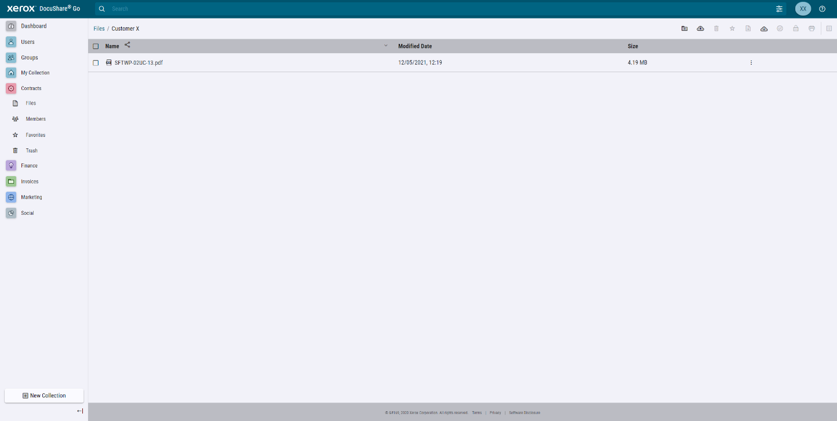
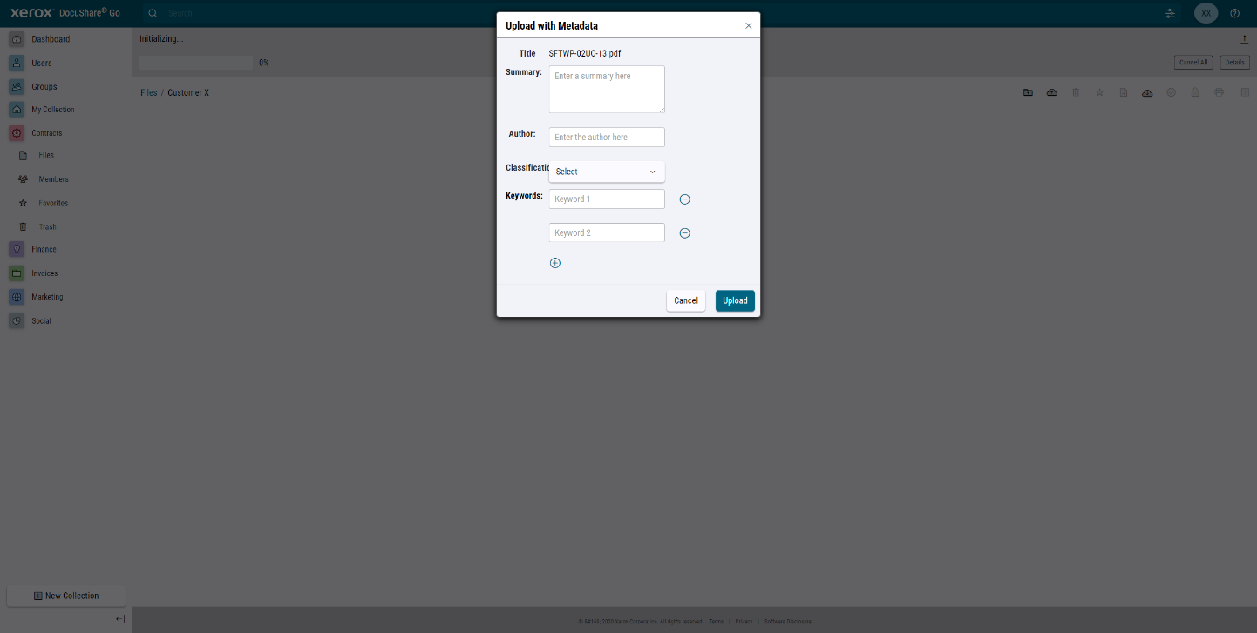
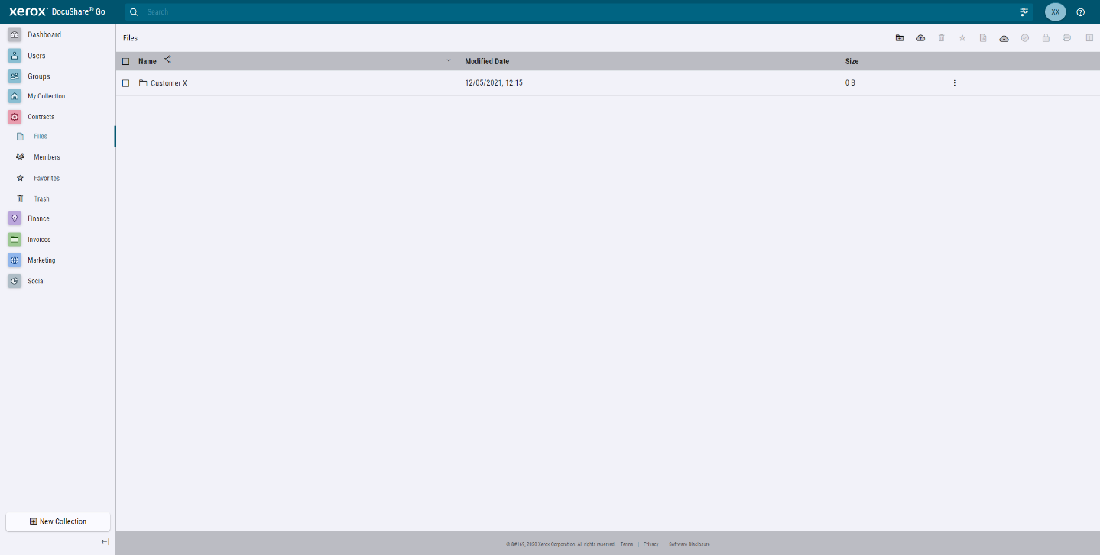
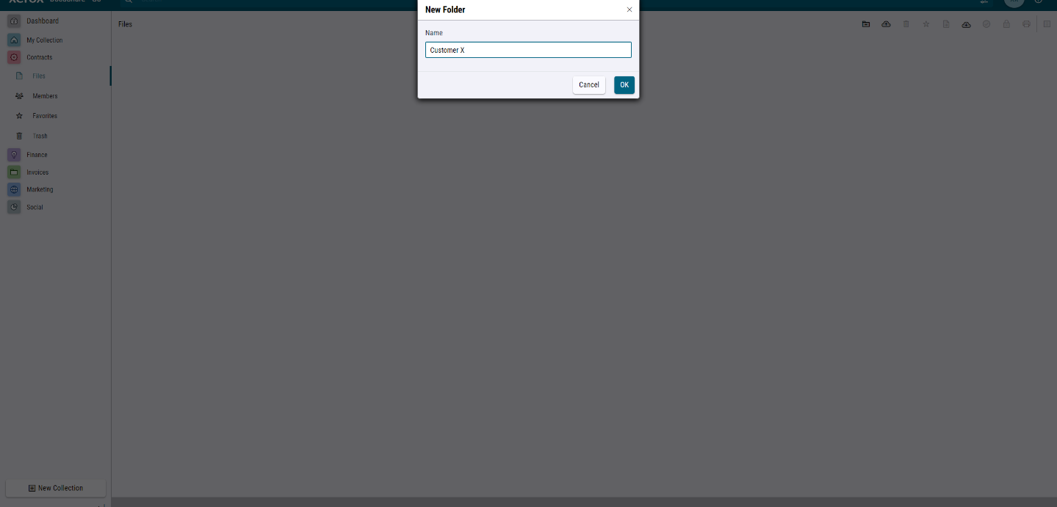
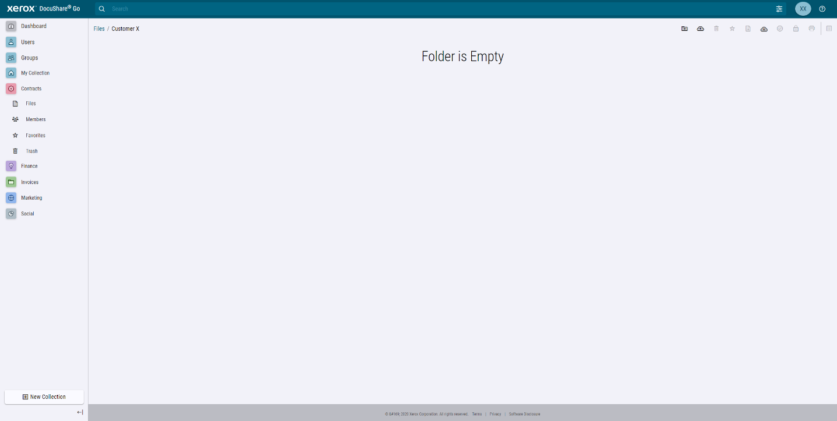
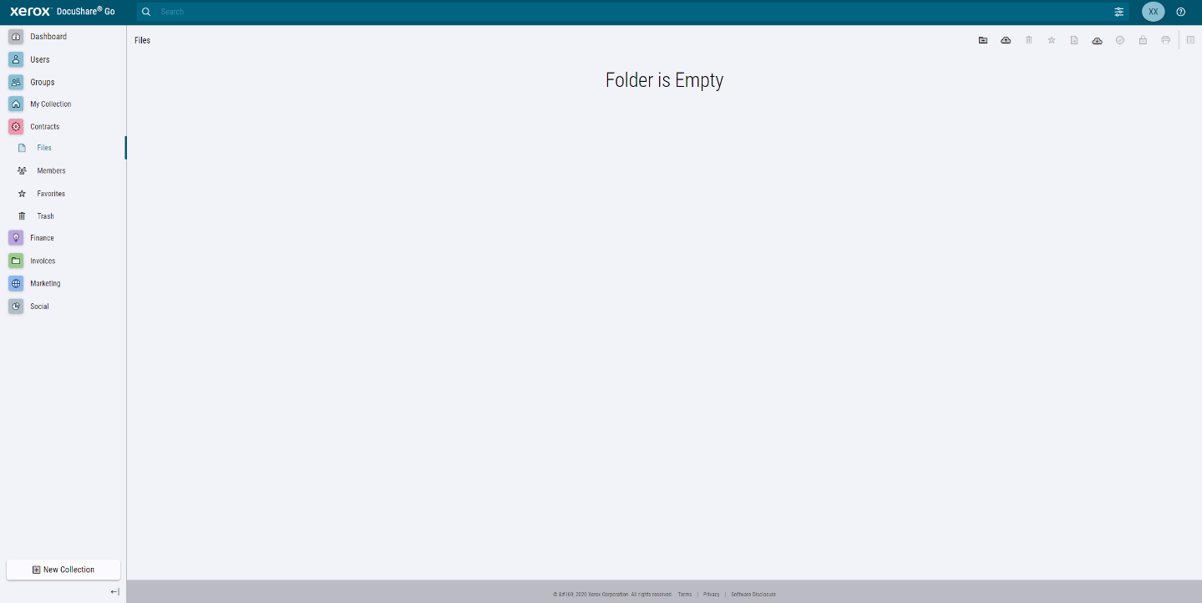
Files and Folders Upload, search, preview, edit, and share.
FOLDER CREATION
Get up and running quickly and without any training.
Select “New Folder” to create new folders
Drag and drop entire folders from PCs or servers maintaining original content and structure
UPLOADING OPTIONS
Drag and drop files/folders without adding metadata (PC)
Drag and drop files/folders adding metadata (PC)
Browse and navigate (PC/Mobile)
ConnectKey App (Xerox® ConnectKey® Technology-enabled MFPs only)
Notes:
Organization of files is key, but we all organize in our own way and that’s why DocuShare Go allows users to easily create a folder structure that suits them.
Folder creation is as simple as clicking the ‘add folder’ icon then naming it accordingly, just like a PC.
Getting files into folders is drag and drop simple, whether you add an individual file or transfer a whole folder full of files, Go makes it fast and painless.
Users can also upload files from their mobile device and even go directly from their ConnectKey enabled MFP via the DocuShare Go ConnectKey app, both avoiding the need to send files to their email before uploading to the site.

Slide 11
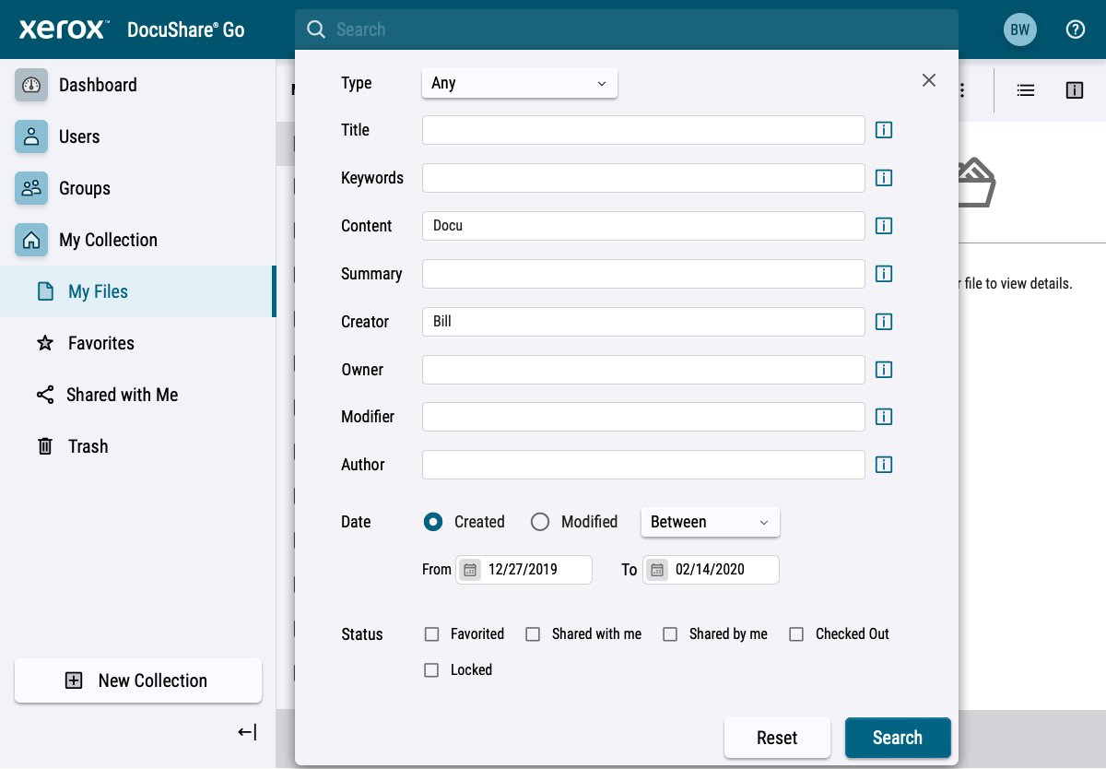
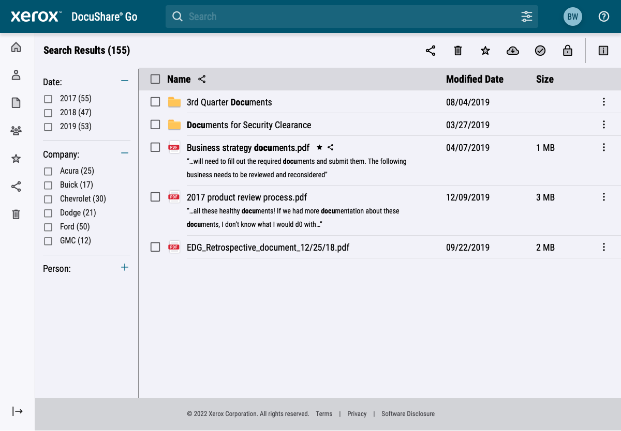
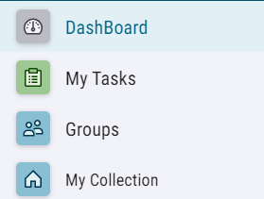
Files and Folders Upload, search, preview, edit, and share.
WAYS TO SEARCH
Advanced tagging makes documents easy to find, filtering enables users to narrow down search results further.
Basic / Quick Search:
Allows users to enter search terms within the search bar, results can then be filtered if required.
Advanced Search:
Allows users to enter multiple terms and use multiple filters at point of search to minimize results, these include:
Document Type
Creator
Date range
Status
See how to search here
Notes:
A key capability of DocuShare Go is for users to find files in the shortest possible time, although careful organization can help, when folders expand with many files, locating the exact one becomes time consuming.
Go offers two search options, basic and advance.
Basic search can be accessed from the top search bar, users simply type in a key word then Go will return all files containing that word, you can then filter if needed.
Advanced search can be accessed via the advanced search icon found to the right of the basic search bar, users can now be more specific about the file they are trying to locate by entering any number of search terms or date range.

Slide 12
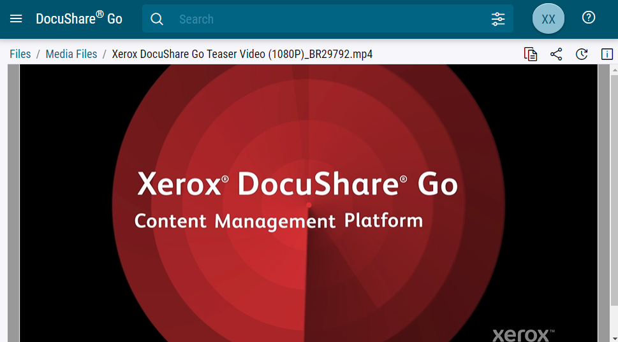
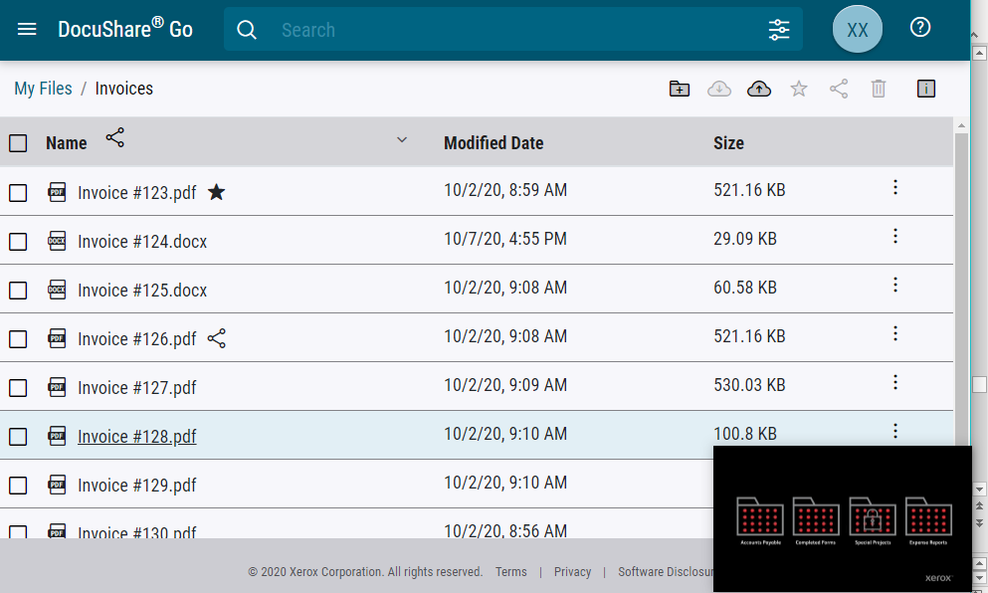
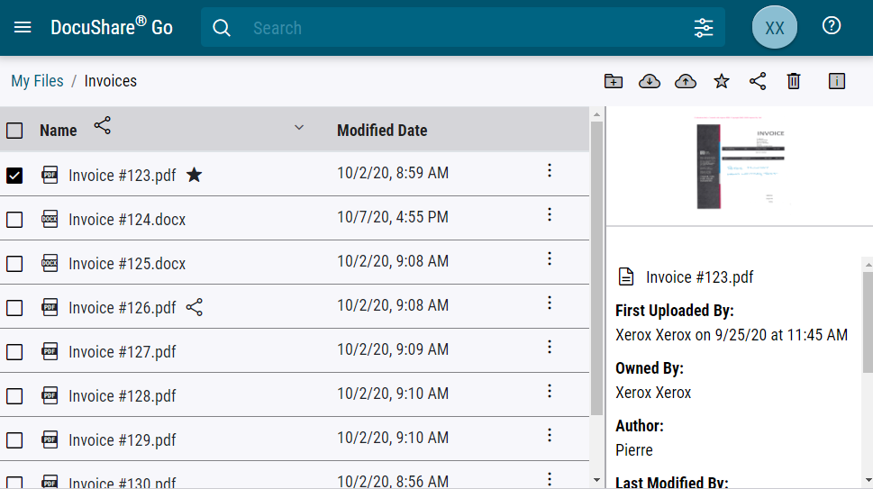
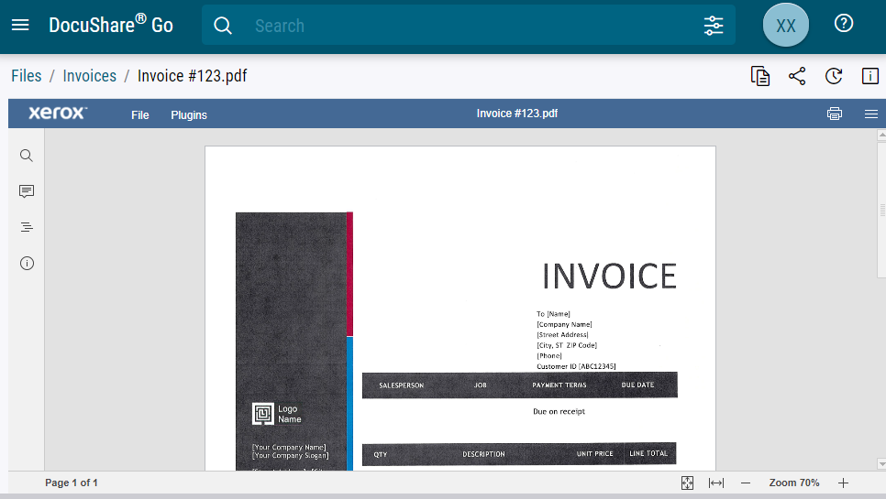
Files and Folders Upload, search, preview, edit, and share.
PREVIEW AND STREAMING
Files no longer need to be downloaded to be viewed or played.
Preview files
One click file summary with thumbnail gives an instant overview of each file
Find and preview the entire document in a few clicks
Stream video content
One click file summary gives an instant overview of each file
Picture in picture mode for media files allowing users to continue using the site while viewing the video
Notes:
Another benefit of DocuShare Go is the ability to preview files or stream media content within the platform instead of downloading each file to your PC first. This not only helps to save time and network bandwidth, but also keeps the files centrally hosted versus scattered on individual PC’s.

Slide 13
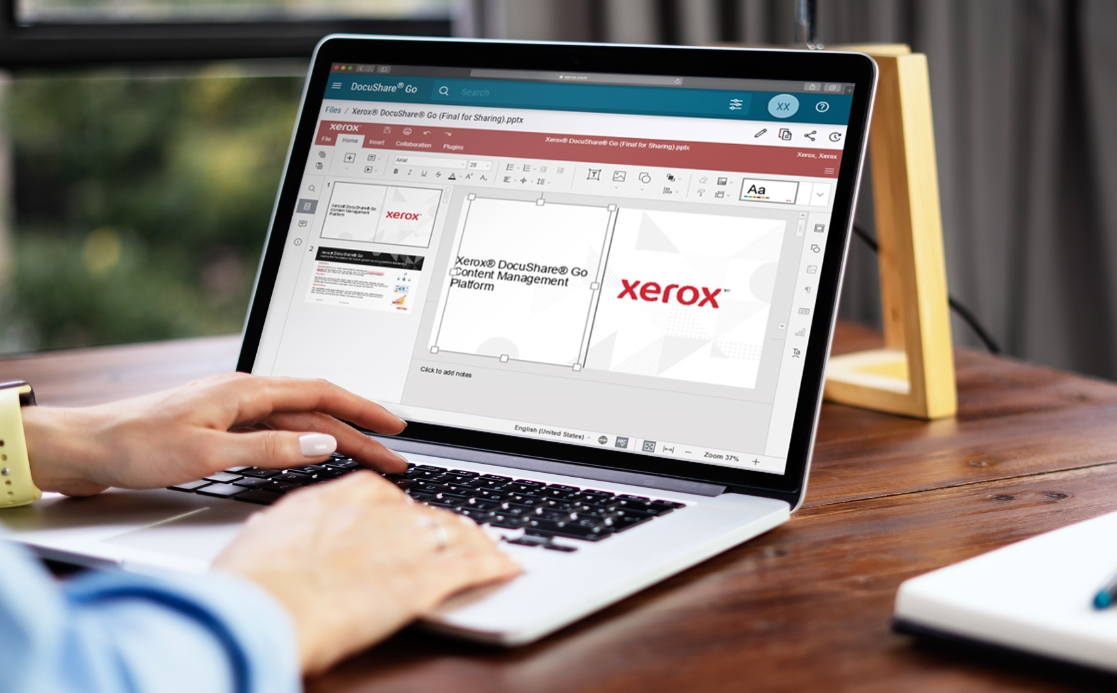
Files and Folders Upload, search, preview, edit, and share.
EDITING AND VERSION CONTROL
Edit certain office file types within the platform without having to download and edit on a local PC.
Standard editing features available
Office files such as Word, PowerPoint and Excel supported
Co-editing mode
Additional user comments
Word search to help find relevant content quickly within the document while open
Notes:
Controlled document collaboration is key for any business to be successful, any failing could cause wrong or out of date versions being sent to customers, worst still, exposing businesses to compliance fines and more.
Go brings a new dimension to document collaboration by allowing users, individually or concurrently, to edit files within the platform, again avoiding the need to download and share through unsecure and uncontrolled means.
Fast co-editing mode automatically saves any edit when made, versioning control is also automatic, meaning anyone accessing the file will always see the latest even if another user is editing at the time.
Another advantage of editing within Go, businesses could decide not to have locally installed Office packages on their user PC’s, maybe helping to save a little on software licensing cost.

Slide 14
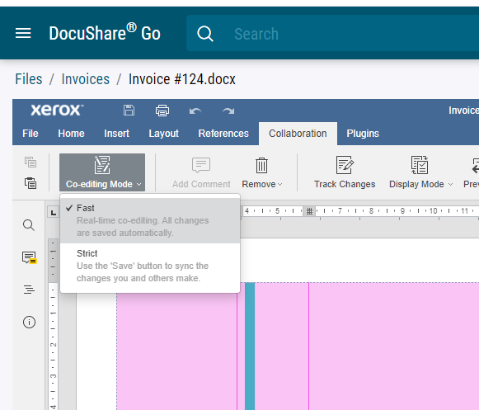
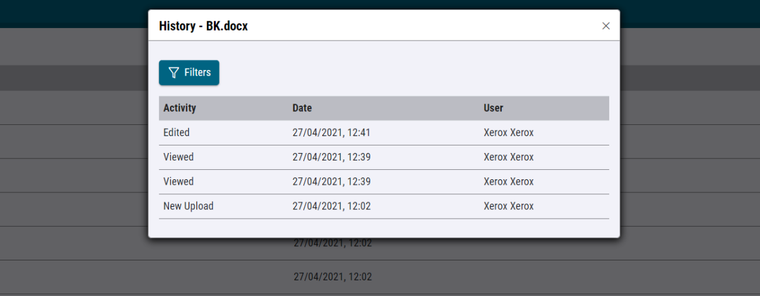
Collaboration Real-time and concurrent.
REAL-TIME COLLABORATION
Allows for multiple users to edit documents simultaneously, saving any changes instantly so other users see those changes real time.
Two co-editing saving modes
Fast, automatically saves all changes and maintains version control
Strict, requires users to select the save button to sync changes
Version control automatic and seamless
Change history kept
Recover previous versions
Preview and download available
See collaboration in action
Notes:
As mentioned previously, real-time document collaboration is available, however in the event simultaneous changes are not desirable, collaboration can be switched to “strict” mode meaning users need to save their edits manually. In this instance, it’s recommended multiple users do not collaborate on the document at the same time.
You can also choose to lock or check out files, this prevents any other user from making changes to the file although they will still be able to view it.
Lock/unlock
Locking files and folders prevents others from making changes.
Extremely useful when files are deemed to be final or when folders should not be added to.
Locked files can be viewed, shared and downloaded.
Locked files cannot be edited or replaced.
Check in/check out
Check out allows for individual users to download and work on documents while preventing others from making changes at the same time.
Only when the document is checked back in, can others make changes.
Checked out files can be viewed, shared and downloaded.
Checked out files cannot be edited or replaced.

Slide 15
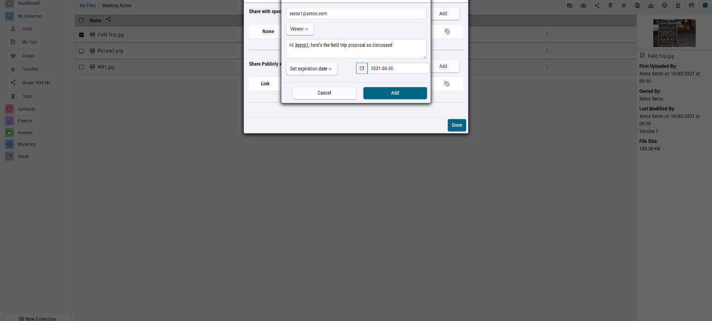
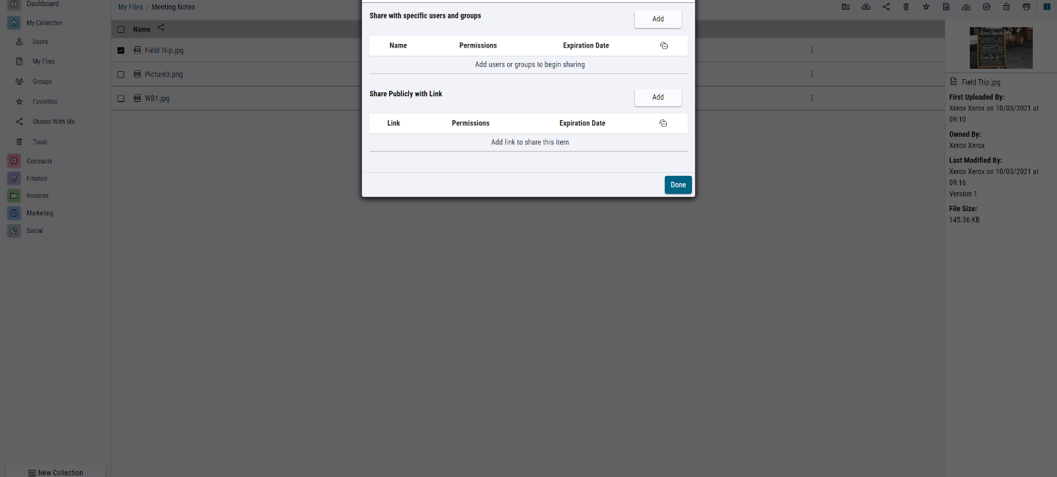
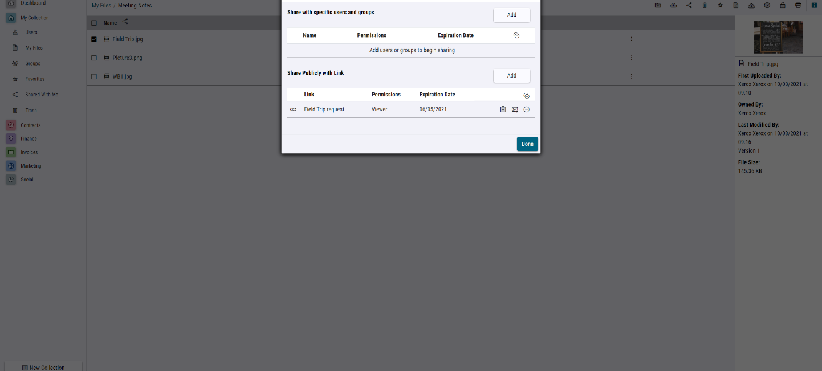
Files and Folders Upload, search, preview, edit, and share.
SHARING
Documents and media files can be shared with any valid email address, meaning you can share with both internal and external* contacts, even if they are not part of the DocuShare Go account.
When sharing:
Choose access permission by user
Editor: Allowed to make changes to the file and upload files to folders
Viewer: Only allowed to view the file or folder
Set share expiry date
Sharing will automatically rescind once the set date has passed
*No DocuShare Go account needed for external collaboration, users receive a link to the specific file / folder only.
Expires 06/05/2023
Notes:
Sharing is simple and secure, whether it’s internal colleagues or external customers. When sharing, only links to the folder or file are sent meaning no transmission of files over unsecure connections.
At the point of sharing, you can choose if the recipient has view only or editing permissions, you can even set an expiry date to ensure deadlines are met.
At any time, users can stop sharing if required.

Slide 16
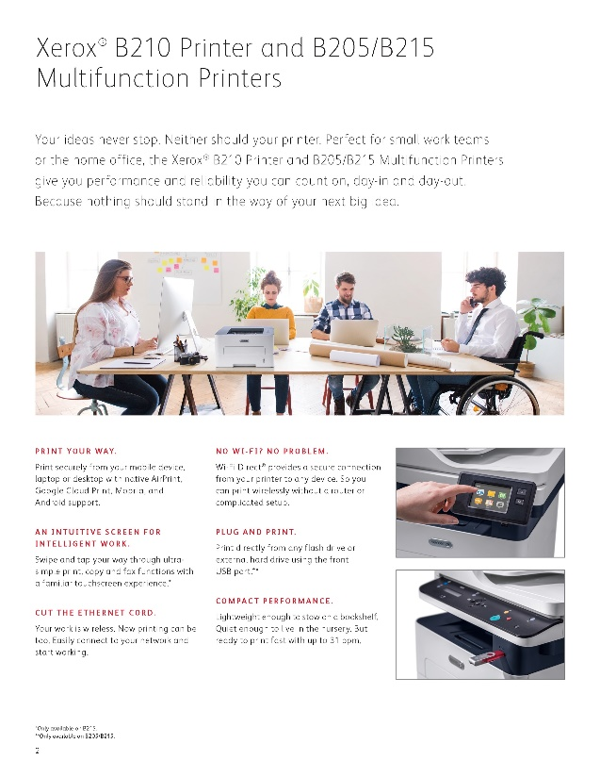
Files and Folders Upload, search, preview, edit, and share.
AUTOMATICALLY TAG DOCUMENTS
Optical Character Recognition (OCR) and Intelligent Character Recognition (ICR) capture documents. Each document is then tagged for easy search and retrieval.
OCR:
Converts standard type fonts to searchable metadata
Users can search for any typed word contained within the document
ICR:
Recognizes letters, words, even handwritten text within captured files then converts it to searchable metadata, e.g., business name on a logo, car number plate, written text within a photograph
OCR
ICR
Multifunction Printers
Print Securely
Performance
Issue 4
Pets Monthly
Add Yellow
Proof
Remove Tags
Notes:
In the past, to make files easier to find, users were reliant on the uploader of the document to place it within the correct folder or manually add ‘meta data’ tags so it can be searched for.
Very often, one or both steps were missed meaning the file would take longer to find or worse still, get lost completely.
To help make this easier, Optical Character Recognition (OCR) was introduced as part of the capture process. This had the ability to convert any text contained within the document to searchable metadata, although this did not file the document in the correct place, it did greatly improve the search capability. A limitation of OCR was the inability to capture non-standard text such as hand-writing or text within images like a picture or a car number plate, and this is where Intelligent Character Recognition (ICR) has an advantage.
A smarter, faster way to work
OCR is the ability to recognize text within a scanned image.
The captured data is stored as a hidden file within the document, allowing users to search the content of the file without needing to open each one.
OCR is limited to standard font capture; however, if this text is part of an image (photograph, logo etc.) OCR does not occur.
Intelligent Character Recognition (ICR) extends from OCR to recognize different styles and fonts of text such as handwriting or non-standard text within company logos.
Both OCR and ICR data is extracted and used to tag the file it came from automatically, meaning users no longer need to add basic metadata manually or even create a structured folder system.

Slide 17
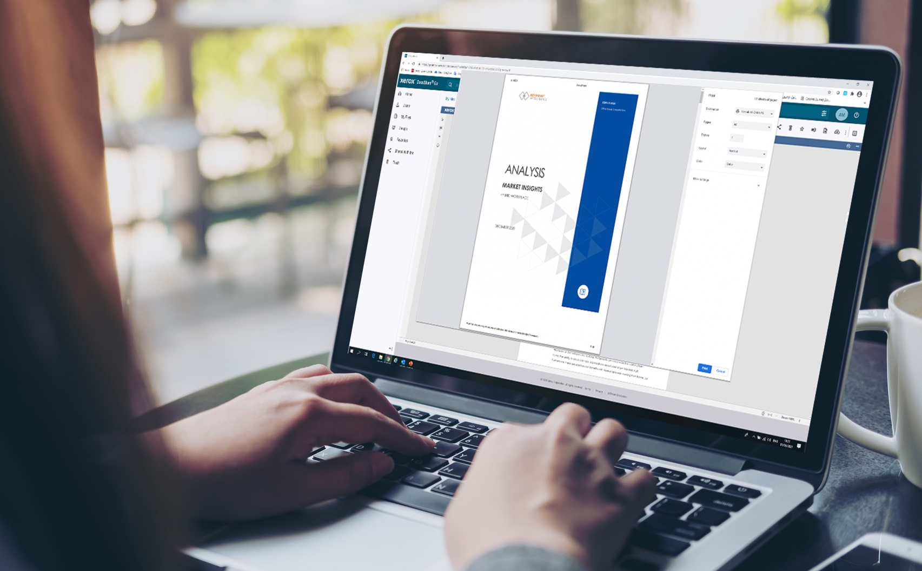
Files and Folders Print files without downloading.
PRINTING
DocuShare Go allows for printing files directly from the platform, avoiding the need to download documents first.
Many file formats supported
Utilizes print drivers/protocols installed on the PC or Mobile device
Full access to print settings such as 2-sided, color/mono
Notes:
Like editing, printing can be done within the platform, avoiding the need to download the file first. DocuShare Go utilizes the print protocol of the device accessing the file, whether it’s the installed PC driver, Apple AirPrint or other.

Slide 18
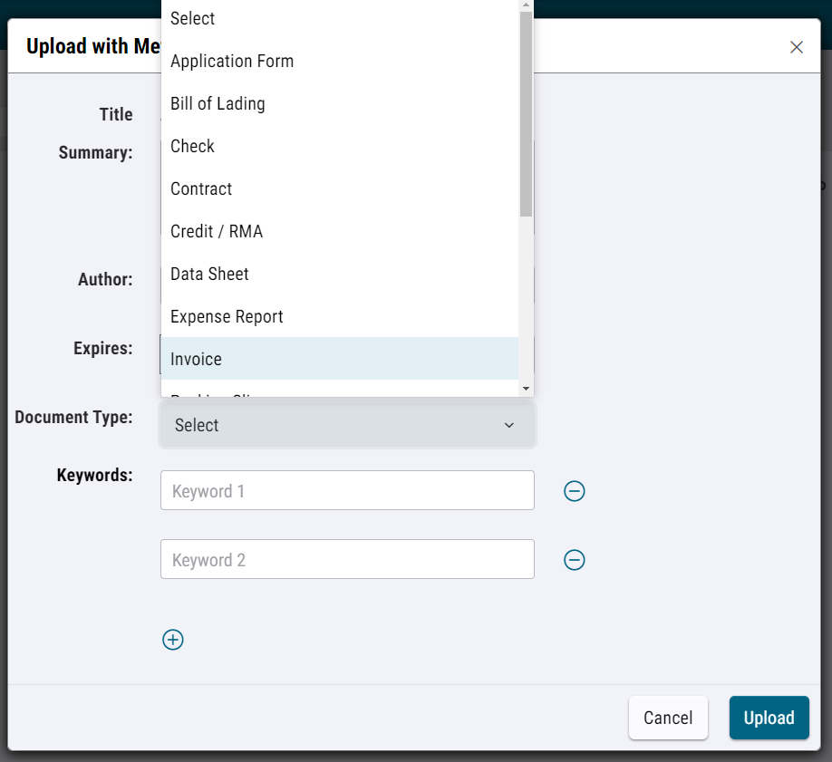
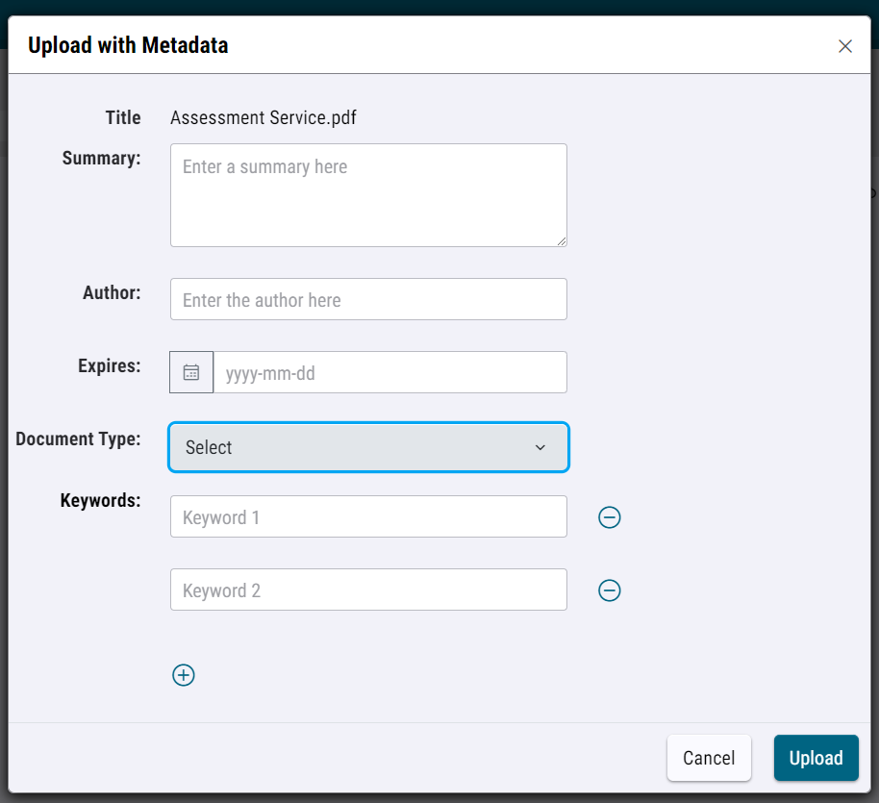
Document Types Add / customize key document terms.
DEFINING FILE & FOLDER TYPE
Files can be defined at point of upload or through folder association. Once classified, it follows the document wherever it is moved to within the DocuShare account.
Uploading individual files
Definitions are selectable from a customizable list via a pull-down menu at point of upload or once stored.
Uploading files into a defined folder
Create a folder and give it a definition. Any document that is then uploaded or moved to that folder inherits the definition.
Notes:
To help organize files in a more structured way, both the file or folder can be classified by type, such as invoices, payments and more.
Classifying files or folders also helps users find documents based on the classified search criteria, i.e. searching for invoices will show all folders and files tagged with invoice.
When users classify a folder, any file imported into it will also inherit the classified tag, allowing users to semi-automate the classifying process.

Slide 19
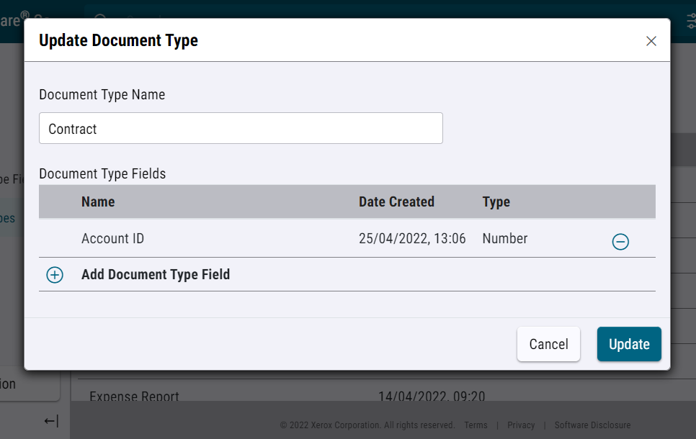
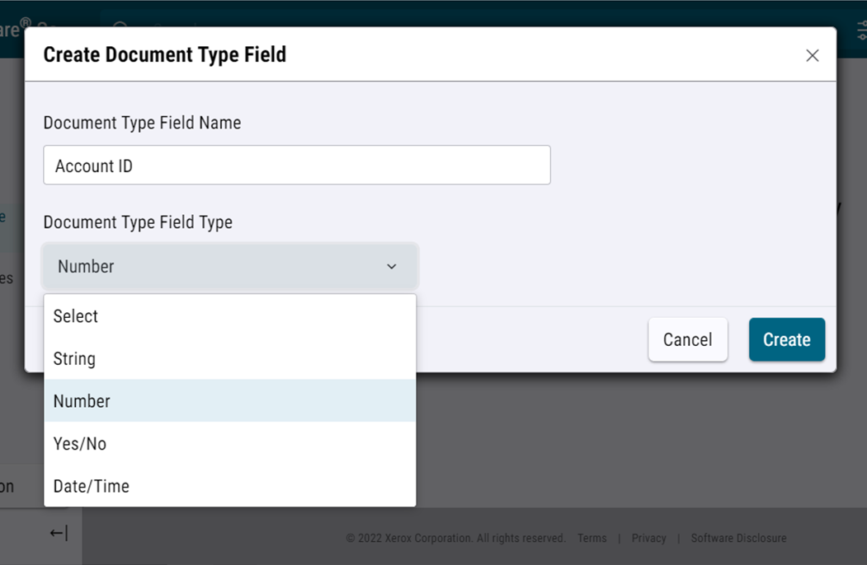
Document Types Add / customize key document terms.
ADD / CUSTOMIZE
Document type and fields can be added and customized to meet individual business needs or terminology used.
1. Document Type
Create custom document types in addition to the preset types already included.
2. Document Type Fields
Create additional meta data fields allowing for enhanced, for flexible search terms to be used (equal to, greater than etc.).
Note: DocuShare search functions have been enhanced to allow searching by custom meta data terms added.
Notes:
DocuShare Go also allows for subscription owners or administrators to add new and/or customize existing document types, this feature helps tailor the platform to meet the individual business needs.

Slide 20
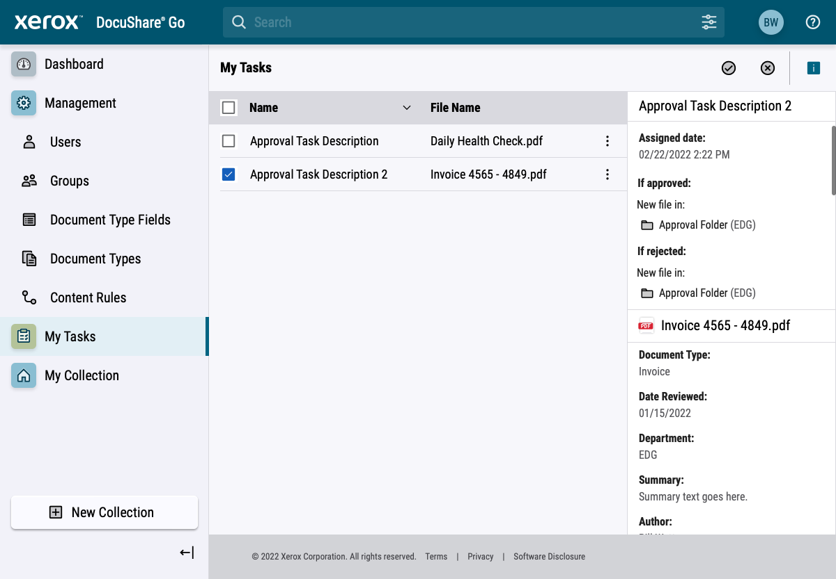
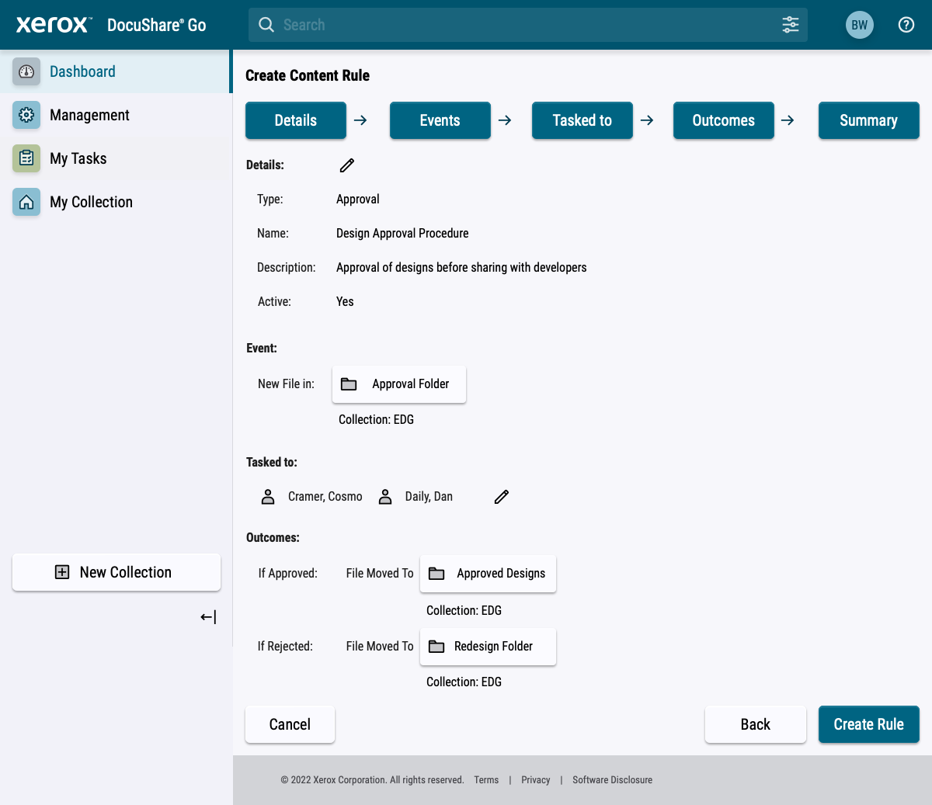
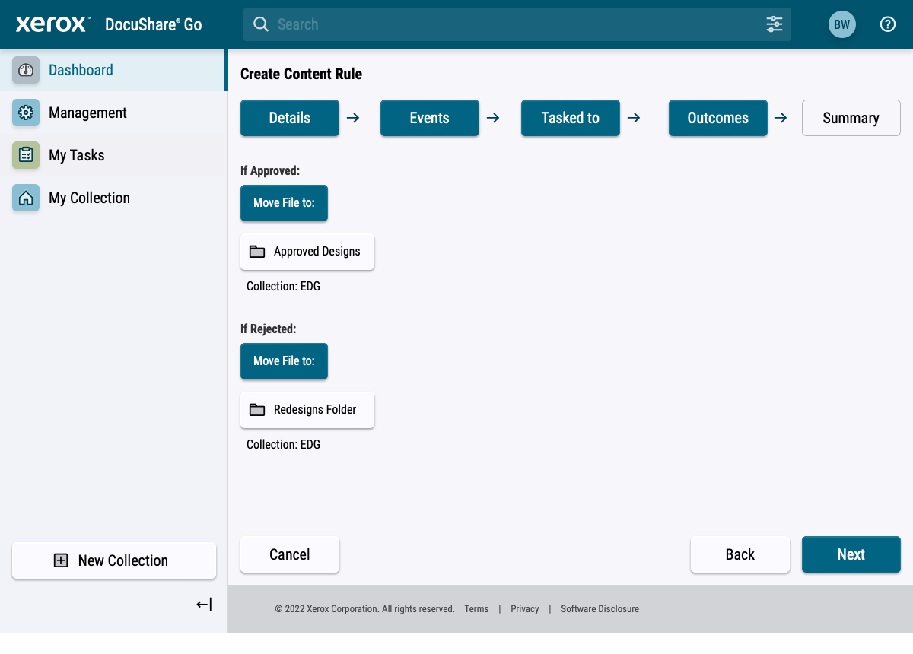
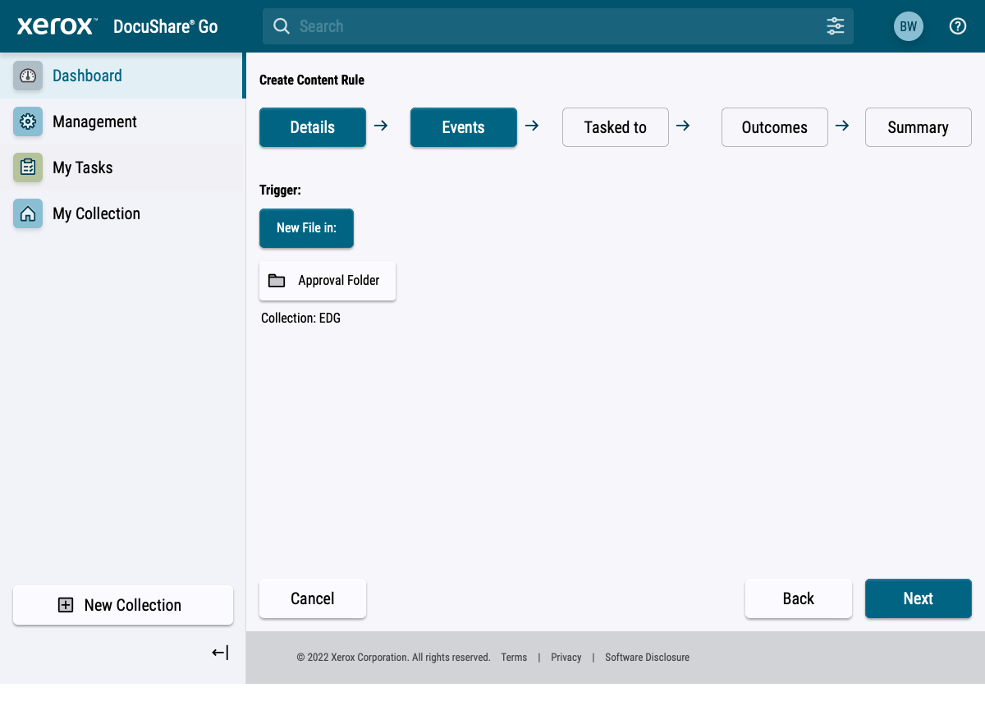
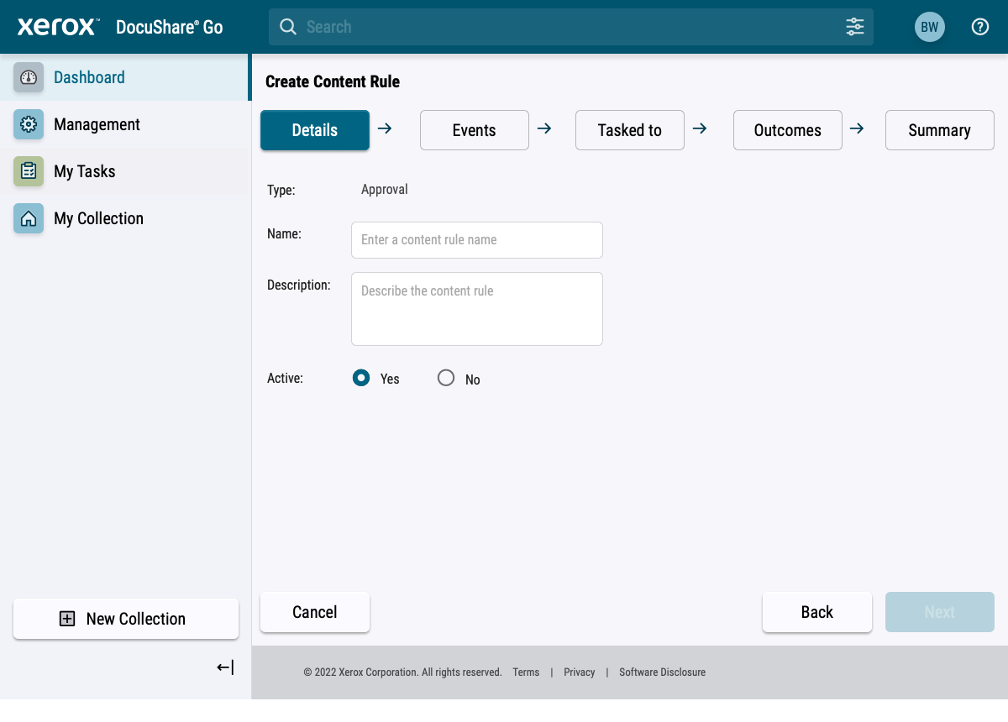
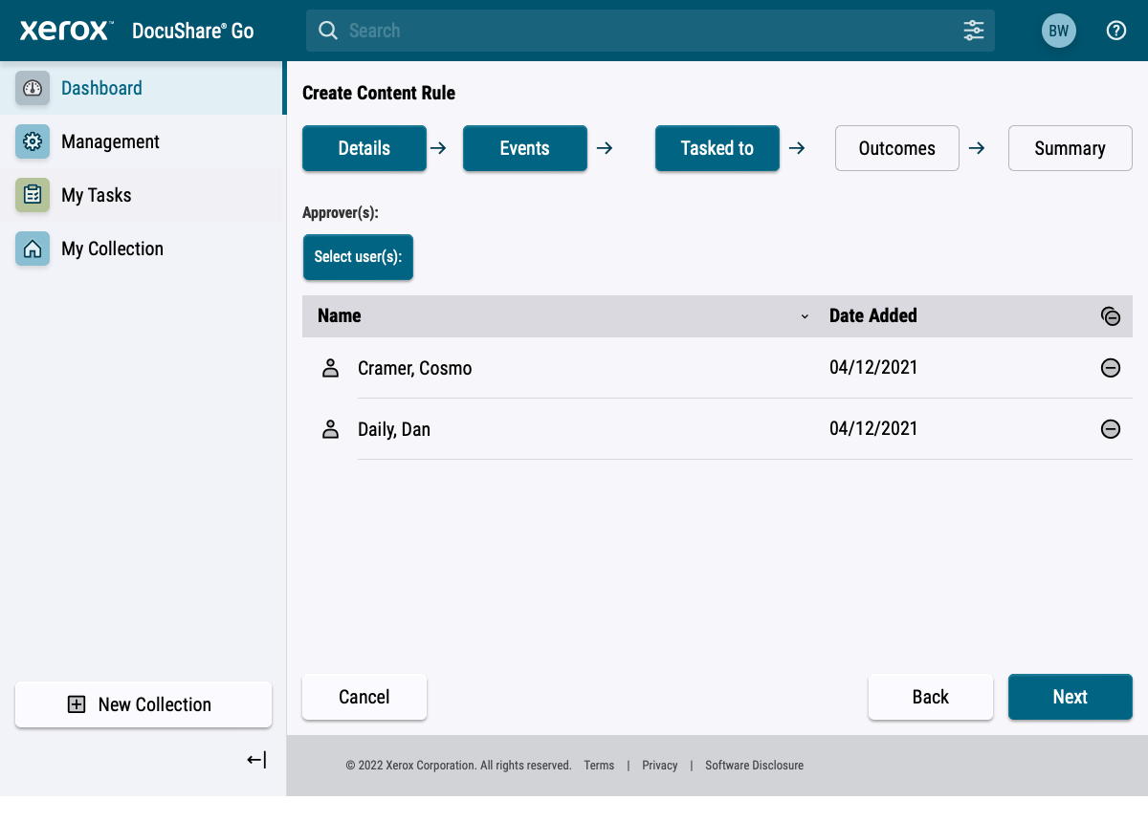
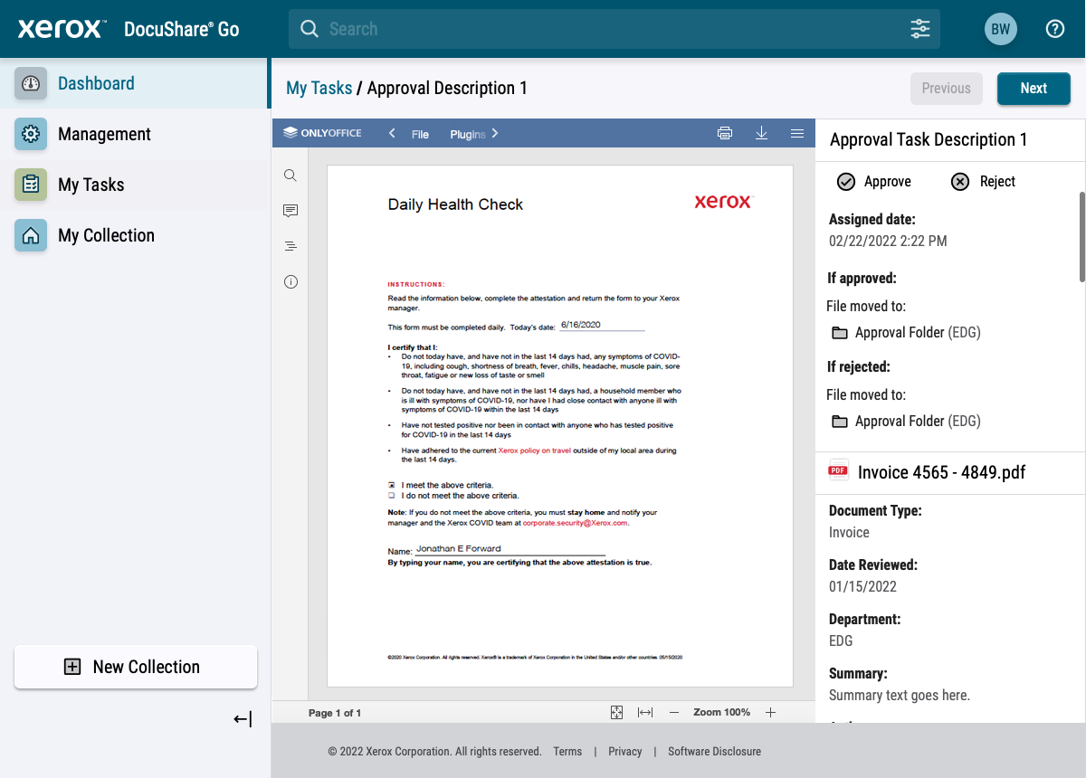
Approval Workflow Creation Streamline and automate everyday process tasks.
APPROVAL AUTOMATION
Content rules allow for admins to create simple approval workflows helping to automate key tasks.
Content Rules (creator):
Simple, wizard driven, 4 step set-up
Create approval or rejection rules for incoming files
Re-route based on approval status
Note: Sequential rules can be set up to support chained approval requirements.
My Tasks (viewer):
Review the status of all tasks
Approve or reject, add comments if required
Notes:
Simple approval workflows can be set-up using a simple creation wizard, once the action/task has been completed, the assignee of the action/task will see an entry within the My Task window.
At this stage, only the account owner or admin can create and assign tasks to only single approvers, future enhancements are planned.
If multiple approval steps are required, chains can be set up by creating new rules that monitor the folder in which the previous rule places documents in.

Slide 21
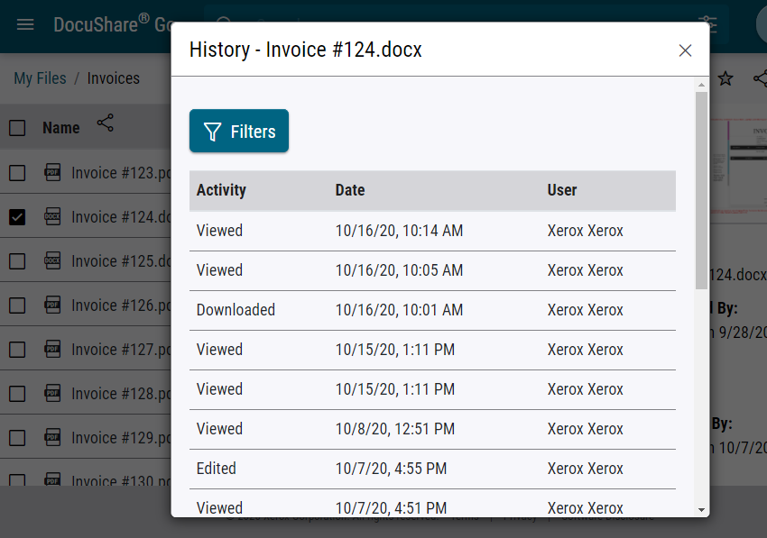
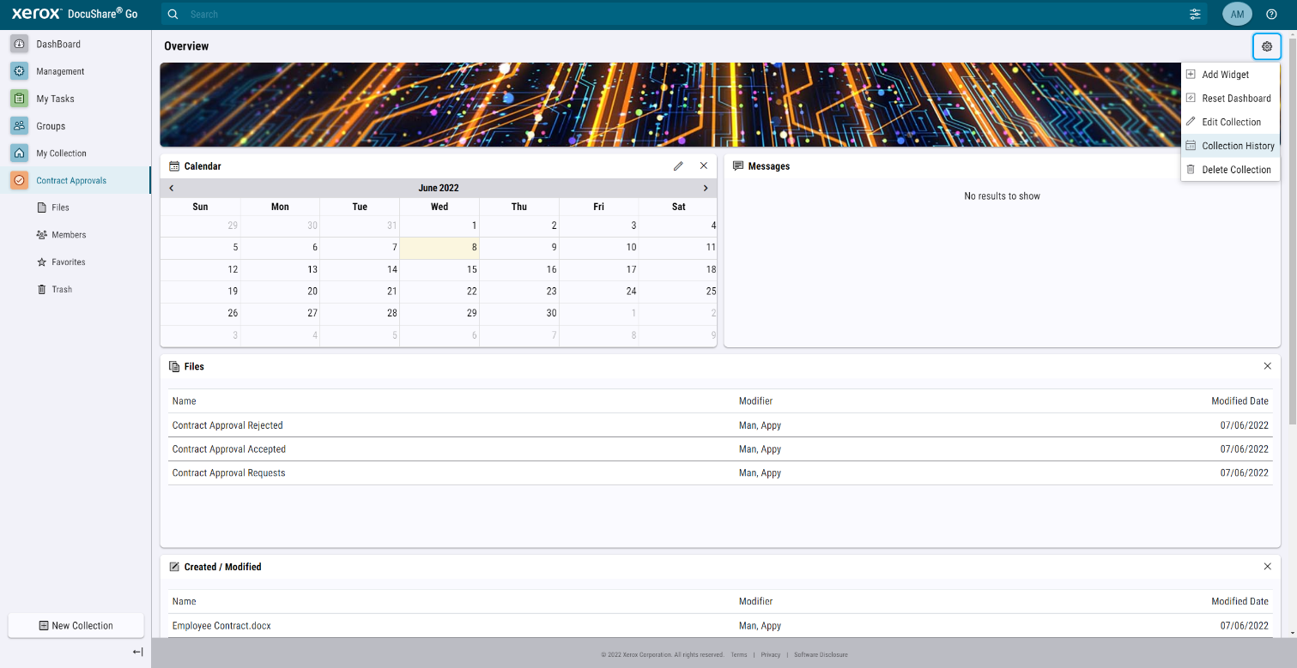
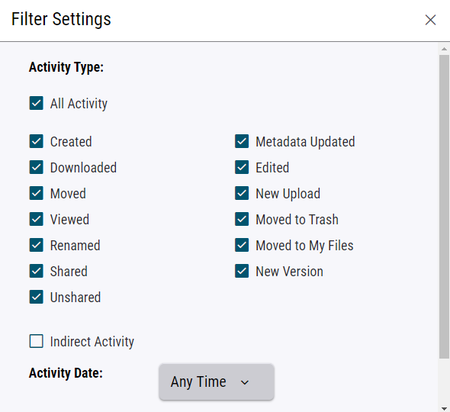
File and Folder History Maintain an audit log of all actions.
AUDIT TRAIL
A complete audit trail is available for each file; the history screen shows all activity by type, date, time and user.
Activity captured include:
Newly Uploaded
Viewed
Edited
Moved
Shared
Renamed
Downloaded
Downloadable Collection History .CSV Report available
Notes:
Having centrally accessible and editable files makes it easy to track all activity, this includes who views, edits, downloads, shares and moves the file, as well as what date and time it happened.
This helps prevent lost files, offers a level of accountability and even prove compliance should the need arrive.
Administrators can also download the complete Collection audit report in .csv format for offline processing.

Slide 22
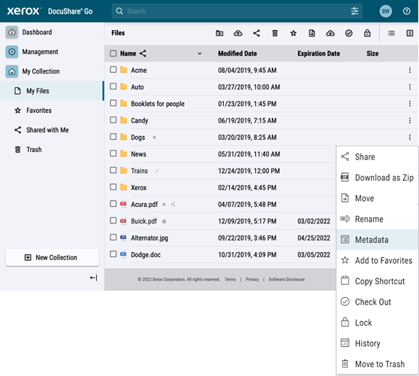
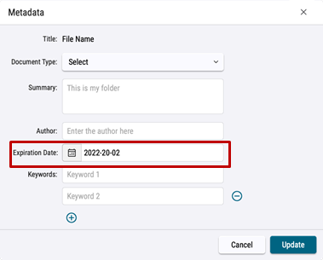
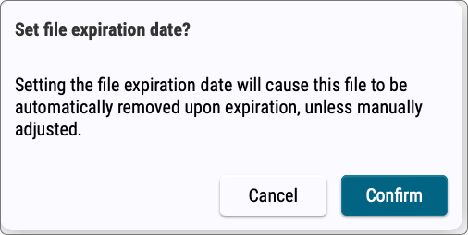
File Retention Policy Manage the document lifecycle.
SET EXPIRY DATES
Setting expiry dates help businesses manage document lifecycle and supports data compliance initiatives.
Retention Policy Actions:
Files will be moved to the trash bin when they expire, and consequently removed in 60 days.
Changes to the file expiration date will be tracked within the file and collection histories for auditing purposes.
Note: Once the 60-day trash bin limit is reached, the file will no longer be accessible, it will be permanently deleted.
Notes:
To support data compliance goals, DocuShare Go allows users to set expiry dates to any document. If the document expires, it will be placed into the users trash bin for 60 days before being permanently deleted.
Once permanently deleted, there is no way to recover the file.

Slide 23
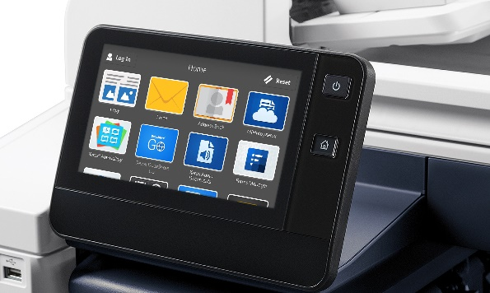
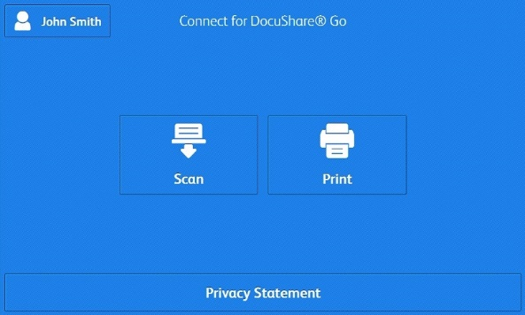
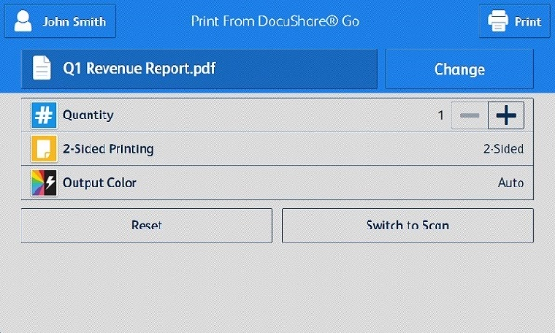
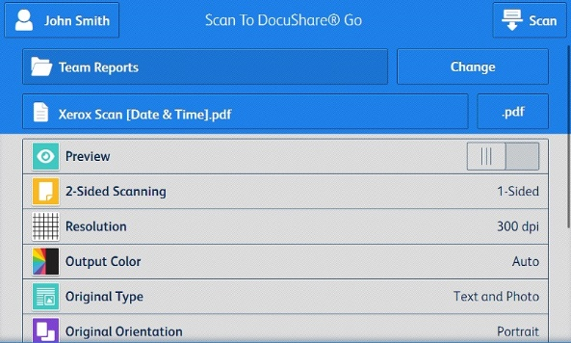
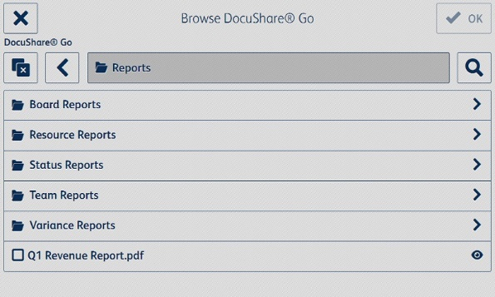
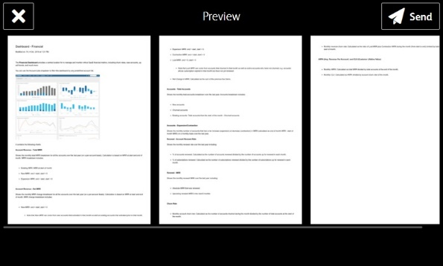
Xerox® Connect App Get more out of your printer.
KEY FEATURES
With Xerox Connect App for DocuShare Go, users can connect Xerox ConnectKey Technology-enabled multifunction printers directly and securely to their DocuShare Go account.
Single Sign-On*:
Associate DocuShare login credentials with your business authentication solution
Image Preview:
View scanned pages before submitting to avoid errors or missed pages
Email Copy:
Concurrently send a copy of the scanned file to email recipients
Collection / Folder Navigation:
Easy navigation including file search enables users to find documents quickly
*Supported authentication required, e.g., Xerox® Workplace Solutions (www.xerox.com/workplacesolutions)
Notes:
The ConnectKey app allows businesses to directly link their ConnectKey enabled MFP, to their DocuShare Go account, giving instant access to files and folders on these shared devices.
For home workers with ConnectKey enabled desktop devices, they can print and scan from their home location safely and securely without the need for VPN connections.
When convenience authentication is enabled, the ConnectKey app works with Single Sign On avoiding the need for users to enter their username and password.
Other features of the app include Image Preview, Email a Copy of a scanned document and intuitive folder navigation.

Slide 24
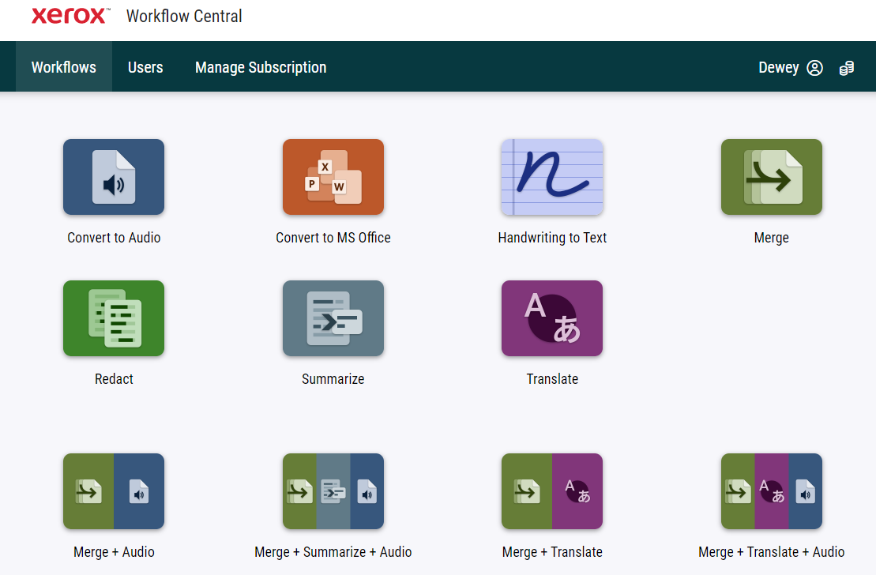
Xerox Workflow Central Convert files into more usable, and actionable, formats.
KEY FEATURES
Xerox Workflow Central Platform makes it easy to transform documents instantly from any device, including PCs, tablets, mobile devices and multifunction printers.
Start with physical or digital files:
Import digital files from DocuShare Go*
Define your workflow:
Convert documents into more usable formats such as Word, Excel, MP3
Transform into different languages or redact sensitive data
Select from over 10 pre-set combination workflows
Choose your output
Email, download, print from MFP or route to back to DocuShare Go* or other popular cloud repositories:
Input Source
Output Destination
*Only available with US data center hosted accounts (EU support Oct 2022).
Notes:
Xerox Workflow Central is a cloud-based solution that takes the guesswork out of converting physical and digital files into usable formats. Workflow Central makes it easy to transform documents instantly from any device, including PCs, tablets, mobile devices and multifunction printers.
Ideal for on-the-go employees that work across a variety of devices and document types, Workflow Central solves everyday workflow challenges, such as translation, redaction, file conversion, and more.
Documents can be imported from, and routed back to, other cloud repositories such as DocuShare Go, helping to further streamline the conversion process.

Slide 25
Support Online and always available.
VIRTUAL AND INSTANT
DocuShare Go is designed to be simple and intuitive with minimal training required. But if help is needed, it's only a click away.
24/7 bot* support:
Easily accessible from the help menu
Can answer most standard questions
Online support community site** containing:
FAQs
Quick Start Guides
Tutorial Videos
User Blog
*English only.
**English only, support for Chrome/Edge browser translation capability.
Notes:
Like any modern-day cloud hosted platform, support needs to be instant and convenient.
DocuShare Go offers an always on Chat Bot to answer commonly submitted support questions, if it cannot solve the user problem, it will then point them to the community site where users can find FAQ’s, Guides, Videos and even post support questions to the DocuShare Go team that constantly monitor the site.

Slide 26
Xerox DocuShare Go Content Management Platform Q&A
Notes:
Thank you for your time, if you have any questions, I can answer them now.

